Slide 1
Project Proposal
ATGS (Academic Ticketing and Graduation System)
Team 1337

Slide 2
Contents
1.
Meet the Team
2.
Current System & Solution & Objectives
3.
Project Timeline
4.
Modes of Operation
5.
Operational Scenarios
6.
Software System Attributes
7.
UML Component Diagram

Slide 3
ATGS
Meet the team
Kyran McCown
Bardia Ahmadi
Max Melner
The other Junior in the class.
Will mainly work on backend/database
One of the Juniors of the class.
Will be mainly working on the frontend of the project
Senior CS Student.
Will be working on both frontend and backend development.

Slide 4
ATGS
Advisors are hard to reach sometimes. Why not put in a ticket?
Wanna know what classes to pick in week 7?
Good luck! Most students probably have experience with waiting for hours or having to show up at specific times to be able to ask a simple question.
We’re here to change that. With our ticketing system and Graduation planner. You’ll have access to advisors all the time.
Notes:
Bardia

Slide 5
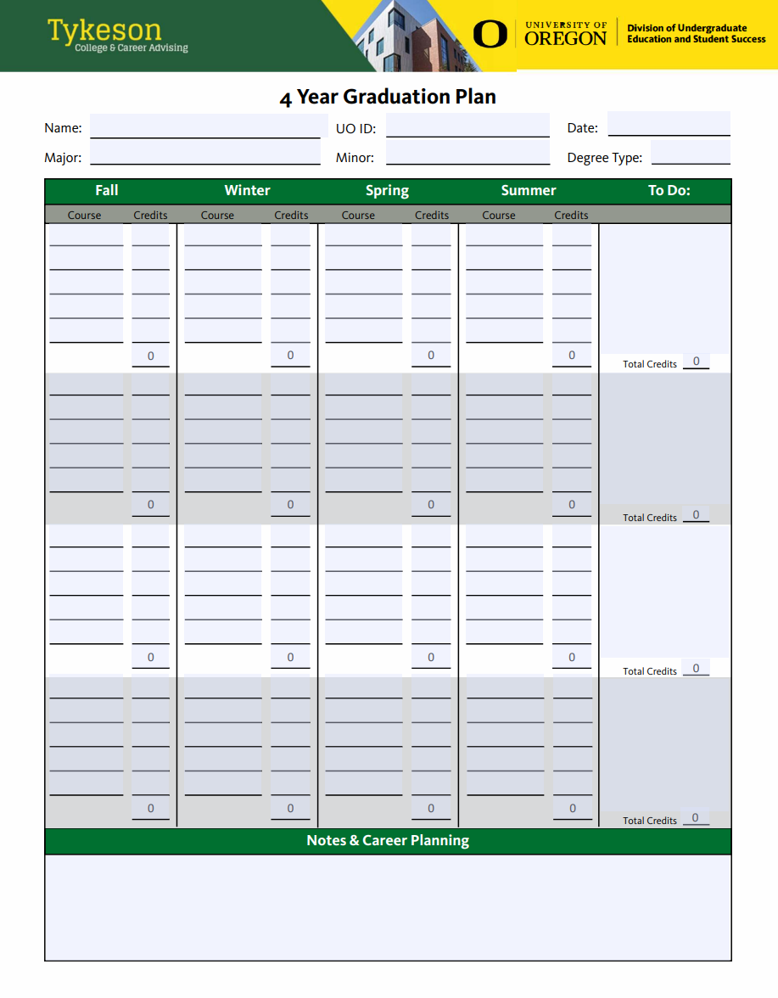
ATGS
Current System
Have an academic question that you want to ask an advisor?
1. Meet in person?
Students can either show up at the specific drop-in hours
Book an appointment on Navigate 360
2. Meet online? Tykeson Hall too far?
You can only do so by booking an appointment
You can see that not a lot of flexibility is considered on what kind of questions students might have.
Whether your question takes 5 minutes to answer or an hour, you only have these options.
Notes:
Kyran

Slide 6
ATGS
Problem?
Students’ time matters:
Booking an appointment or clearing your schedule for drop-in hours is hard
Sometimes students go without knowing the answer to their questions
Planning your courses for your graduation can be confusing, with an extensive course catalog and unclear requirements
Asking questions in person has its flaws:
Students might forget to note something important
Got another question sometime after the appointment
Notes:
Max

Slide 7
ATGS
The solution
Introducing ATGS:
Academic Ticketing and Graduation System
Streamlines the advising process for both students and advisors.
Enables faster and easier student access to advising support.
Increases advisor efficiency by reducing unnecessary appointments.
Allows quick responses through email-based ticketing.
Helps the Office of Academic Advising monitor advisor performance and resource use.
Includes a graduation planner to automate and simplify degree planning, saving time for both students and advisors.
Notes:
Kyran

Slide 8
ATGS
objectives
1
2
3
4
How this will help our students and advisors
more questions
Less effort
Full potential of advisors
Monitoring
This ticketing system will allow students to more easily ask their questions and get quicker answers.
Students don’t have to either go all the way to Tykeson Hall or free up their schedule to ask their questions or make a plan for graduation..
By eliminating the unnecessary appointments, we improve the advisors; efficiency, save everyone more time and automate some tasks.
With this ticketing system, the Office of Academic Advising will be able to monitor tickets to improve work quality and workflow.
Notes:
Bardia

Slide 9
ATGS
Project roadmap
Week 9
Debugging, Testing, and Finishing Touches!
Week 6/7/8
Graduation Planner Implementation
Week 6
Advisor and Admin Dashboard Implementation
Week 4/5
Implement Core Ticketing Features
Week 3/4
Database and Authentication Implementation
Week 2/3
Project Organization and Planning
Notes:
Max

Slide 10
ATGS
Modes of Operation
Ticket Creation:
Students submit tickets describing academic or administrative issues (e.g., missing grades, transcript requests, or course registration problems).
Ticket Assignment:
The system automatically routes the ticket to the appropriate department or staff member based on the issue type.
Tracking and Communication:
Students can track status updates (e.g., pending, in progress, resolved). Staff and students can exchange comments, attach supporting documents, or schedule a meeting.
Resolution and Closure:
Once the issue is resolved, staff mark the ticket as closed. Feedback is collected from the student for quality assurance.
Notes:
Max

Slide 11
ATGS
Operational Scenarios
Student Submits a Ticket
User Responds to a Ticket
Preconditions
The student is a UO student with an active DuckID
The student can access the internet through an internet browser
The student is logged in through the UO login
Preconditions
The user is assumed to have an active DuckID
The User can access the internet through an internet browser
The User has access to at least a ticket
1
Steps to complete:
The Student heads to our website
After logging in, they press the new ticket button
In the newly opened window, they fill out the form with their questions and required fields
Press submit
2
3
Postconditions:
The student is provided with a page where they can see the ticket they just made with their ticket number
Steps to complete:
The User chooses the ticket they want to comment on and opens it
They either choose another comment to reply to or want to make a new one
Press the comment on the related comment
Write out their comment or reply
Press submit
Postconditions:
The user should see an instant update with their comment added to the ticket, and the status of the ticket should be updated and saved on the database. The user who was replied to should be notified.
Notes:
Bardia

Slide 12
ATGS
Software System Attributes
Reliability:
99% uptime during academic terms.
Security:
Strong authentication and encrypted data storage and transfer.
Maintainability:
Modular codebase, clear documentation, and admin controls for updates.
Portability:
Compatible with Chrome, Firefox, and Edge.
Scalability:
Designed to serve additional departments/universities.
Notes:
Kyran

Slide 13
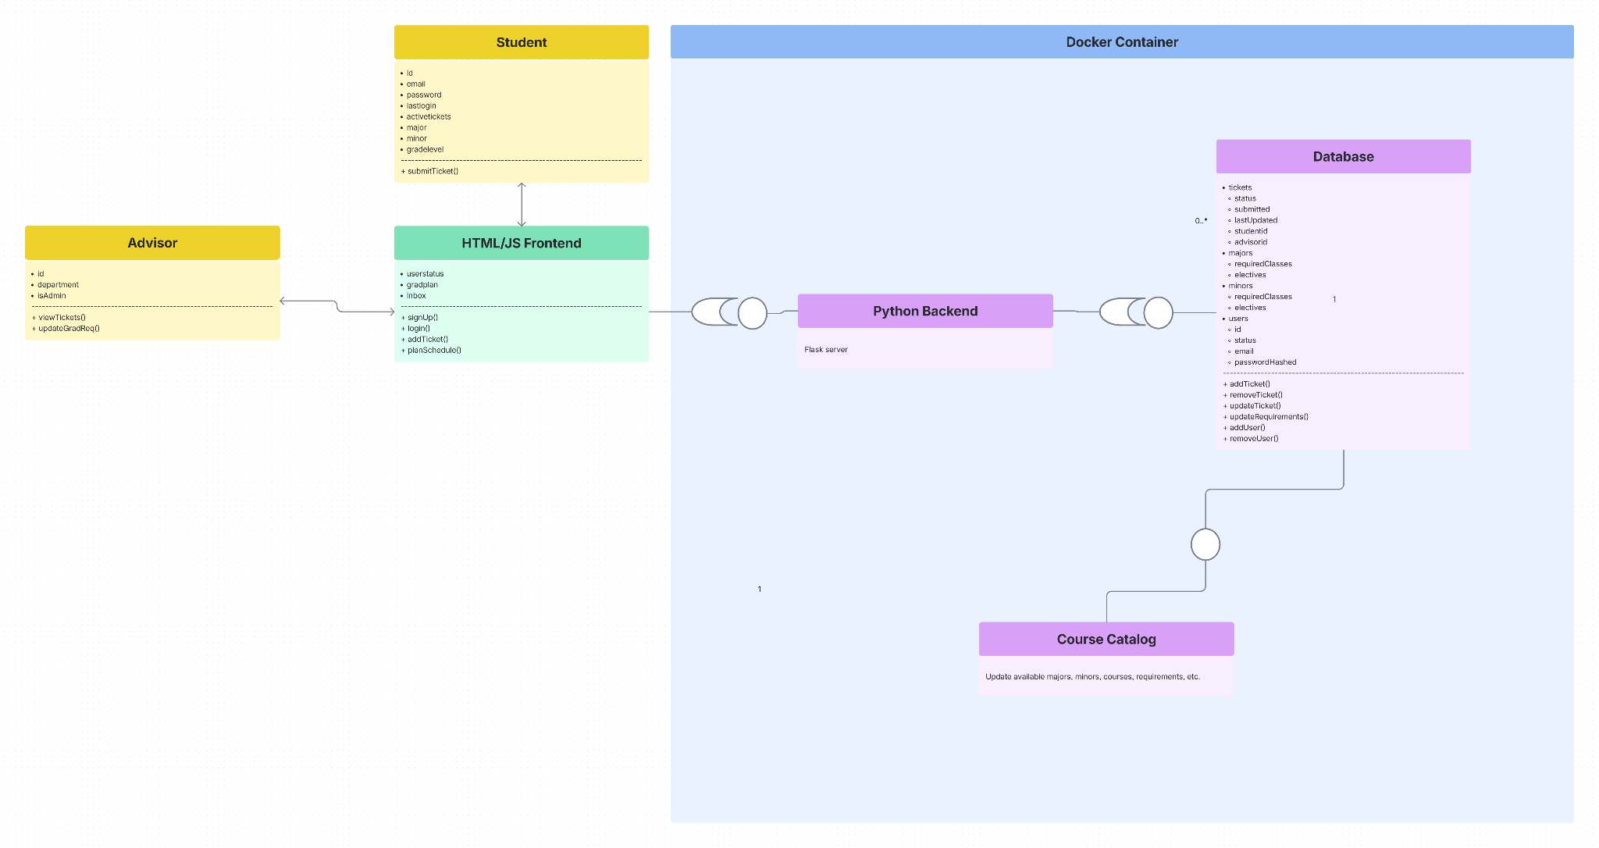
Component Diagram
Notes:
Kyran

Slide 14
Thank you

